Slide 1
Notes:
Presentation on a hyperlocal community Website

Slide 2
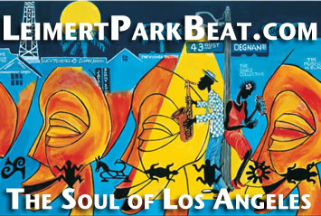
Citilista:
Strengthens communities with a social network linking neighbors, merchants, causes and events in hyperlocal site.

Slide 3
Why Citilista?
Most neighborhoods have no local presence in the news.
Their web presence is hard to find, out of date, unorganized: city hall, chamber of commerce, tourism board.
Businesses create websites, but can’t compete with national chains on Google.
A crowdsourced, niche website is a service to thousands of residents and info for millions worldwide.

Slide 4
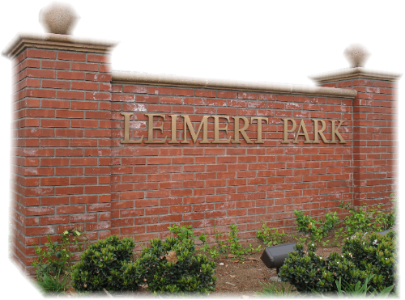
The Challenge of Leimert Park
Size
One square mile.
Population of 7,500.
Unincorporated neighborhood.
Demographics
92 percent African-American.
Older population.
Economics
Family income: $46,709.
35 percent homewowners.
Internet penetration below average.
Notes:
There is a market in Leimert Park

Slide 5
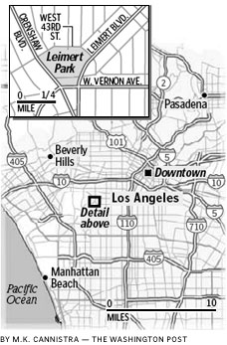
Leimert Park Beat
25,000 unique views since April 2007. 117,000 page views.
2,500 people visit every month.
380 members.
300 blog posts.
660 photos.
180 videos.
200 events listed.
Notes:
Already being used

Slide 6
Compare the Results
Four times the number of people who reside in Leimert Park come to the site each year.
400 Leimert Park mentions a year compared to a total of 125 mentions in the L. A. Times, L.A. Wave and the L.A. Sentinel.
National and local media coverage – N.Y. Times, Tavis Smiley Radio Show, Which Way LA?, LA Observed, Laist, CurbedLA.

Slide 7
Citilista presents the power of .com unity
Commonality of geography – where you live.
Member and business profiles and blogs – connect loyal customers with closest services.
Contributions creates search engine karma:
Leimert Park produces 602,000 results on Google. LeimertParkBeat.com is listed behind only Wikipedia.
Citilista puts every neighborhood, and thus every neighborhood business, at the top of the Google pile.
Citilista also provides a regular audience and crossover.

Slide 8
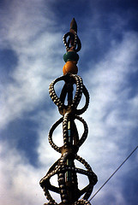
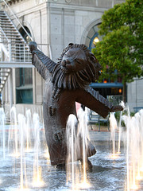
Potential Unilimited
Fairfax
Carson
North Hollywood
Redondo Beach
Eagle Rock
Culver City
Your town
Notes:
Once Leimert Park beat is a success we will move to other markets:
Watts
Eagle Rock Culver City

